Slide 1
Digital Portfolio
STUDENT NAME:
REGISTER NO AND NMID:
DEPARTMENT: BSC COMPUTER SCIENCE AI&DS
COLLEGE: VET INSTITUTE OF ARTS AND SCIENCE

Slide 2
PROJECT TITLE MY PORTFOLIO

Slide 3


AGENDA
Problem Statement
Project Overview
End Users
Tools and Technologies
Portfolio design and Layout
Features and Functionality
Results and Screenshots
Conclusion
Github Link
3/21/2024 Annual Review

Slide 4

PROBLEM STATEMENT
In the current competitive world, both students and recent graduates struggle to effectively showcase their abilities, accomplishments, and projects to recruiters, faculty members, and industry experts. Conventional resumes often fall short in reflecting an individual’s true potential, creativity, and technical expertise. At the same time, recruiters increasingly prefer concise and visually appealing platforms over lengthy documents for evaluating candidates. Without a professional portfolio, there exists a communication gap between what a student can offer and what recruiters expect.
To address this, there is a growing need for a personal portfolio website that offers a structured, user-friendly, and visually engaging way to present a person’s academic background, skills, certifications, projects, strengths, and career aspirations. This project bridges that gap by developing a responsive portfolio website that not only emphasizes academic and technical knowledge but also acts as a digital identity, helping end users evaluate and connect with candidates more effectively.

Slide 5

PROJECT OVERVIEW
This project is centered on creating a personal portfolio website that serves as a digital representation of an individual’s academic background, technical expertise, certifications, projects, and career aspirations in a well-structured and appealing format. The site was developed using HTML and CSS, ensuring simplicity, responsiveness, and easy accessibility. The primary aim of this work was to build an online identity that reflects both personal and professional development. Unlike conventional resumes, this portfolio offers a more interactive and visually engaging way to demonstrate creativity as well as technical skills.The development process involved several important stages, including problem analysis, choosing appropriate tools, designing layouts, writing code, testing, and deployment. The end result is a clean, user-friendly portfolio that can be conveniently shared with recruiters, faculty, and peers. Overall, the project has achieved its goals by producing a functional, organized, and attractive portfolio website, while also laying the groundwork for future improvements such as integrating JavaScript features, adding animations, or hosting it on platforms like GitHub Pages.

Slide 6

WHO ARE THE END USERS?
End Users
The personal portfolio website is intended to serve multiple groups of users:
1)Recruiters and Employers – Provides a professional and organized way to quickly evaluate a candidate’s skills, education, and projects.
2)Faculty and Mentors – Helps in reviewing academic achievements, certifications, and technical contributions.
3)Peers and Collaborators – Supports collaboration by enabling knowledge sharing, project discussions, and team opportunities.
4)Personal Branding – Functions as a digital identity accessible to anyone interested in learning about the candidate’s profile.By addressing these groups, the portfolio goes beyond replacing a traditional resume, offering a versatile platform for career advancement, academic recognition, and personal branding.

Slide 7

TOOLS AND TECHNIQUES
Tools and Technologies UsedThe development of the portfolio website involved the use of the following technologies:
HTML5 – Used to define the structure and layout of the webpages.
CSS3 – Applied for styling, visual design, and ensuring responsiveness across devices.
JavaScript (Basic) – Incorporated to add interactivity and simple dynamic features where required.
CodePen – Utilized as an online environment for writing, testing, and sharing the code efficiently.
GitHub – Adopted for version control, project hosting, and making the portfolio accessible to recruiters.

Slide 8
POTFOLIO DESIGN AND LAYOUT
Website Design LayoutThe portfolio was developed with a clean, modern, and professional appearance, organized into clear sections for smooth navigation:
Header – Displays the profile picture, candidate’s name, and a brief tagline.
Navigation Menu – Provides quick links to different sections like About, Skills, Education, Projects, and Strengths.
About Me – Offers a short introduction including personal information and career goals.
Skills – Showcases both technical and soft skills in a structured, styled format.
Education – Highlights academic background using an attractive card-based layout.
Projects – Describes completed projects in detail, enhanced with hover effects for better interactivity.Strengths – Lists personal qualities such as determination, helpful nature, quick learning, and smart working ability.
Footer – Contains essential contact details along with a copyright note.
8

Slide 9
FEATURES AND FUNCTIONALITY
Key Features of the Portfolio Website
The portfolio is not only designed with a professional layout but also includes practical features that improve accessibility and user experience:
Responsive Layout – Automatically adapts to desktops, tablets, and mobile devices for seamless viewing.
Profile Section – Attractive header displaying photo, name, and a brief introduction.
Navigation Menu – Direct links to quickly move between sections like About, Skills, Education, Projects, and Strengths.
Skills Display – Highlights technical abilities such as HTML, CSS, JavaScript, C, C++, and Python.
Education Cards – Academic details presented in a clean and visually appealing format.
Project Showcase – Completed projects displayed with hover effects for better interactivity.
Strengths – Lists qualities like determination, helpful nature, quick learning, and smart working.
Contact Section – Provides essential contact details neatly in the footer.
Modern UI Design – Light blue theme, subtle shadows, and rounded corners for a polished look.Easy Maintenance – Structured design allows smooth updates to content and style in the future.

Slide 10
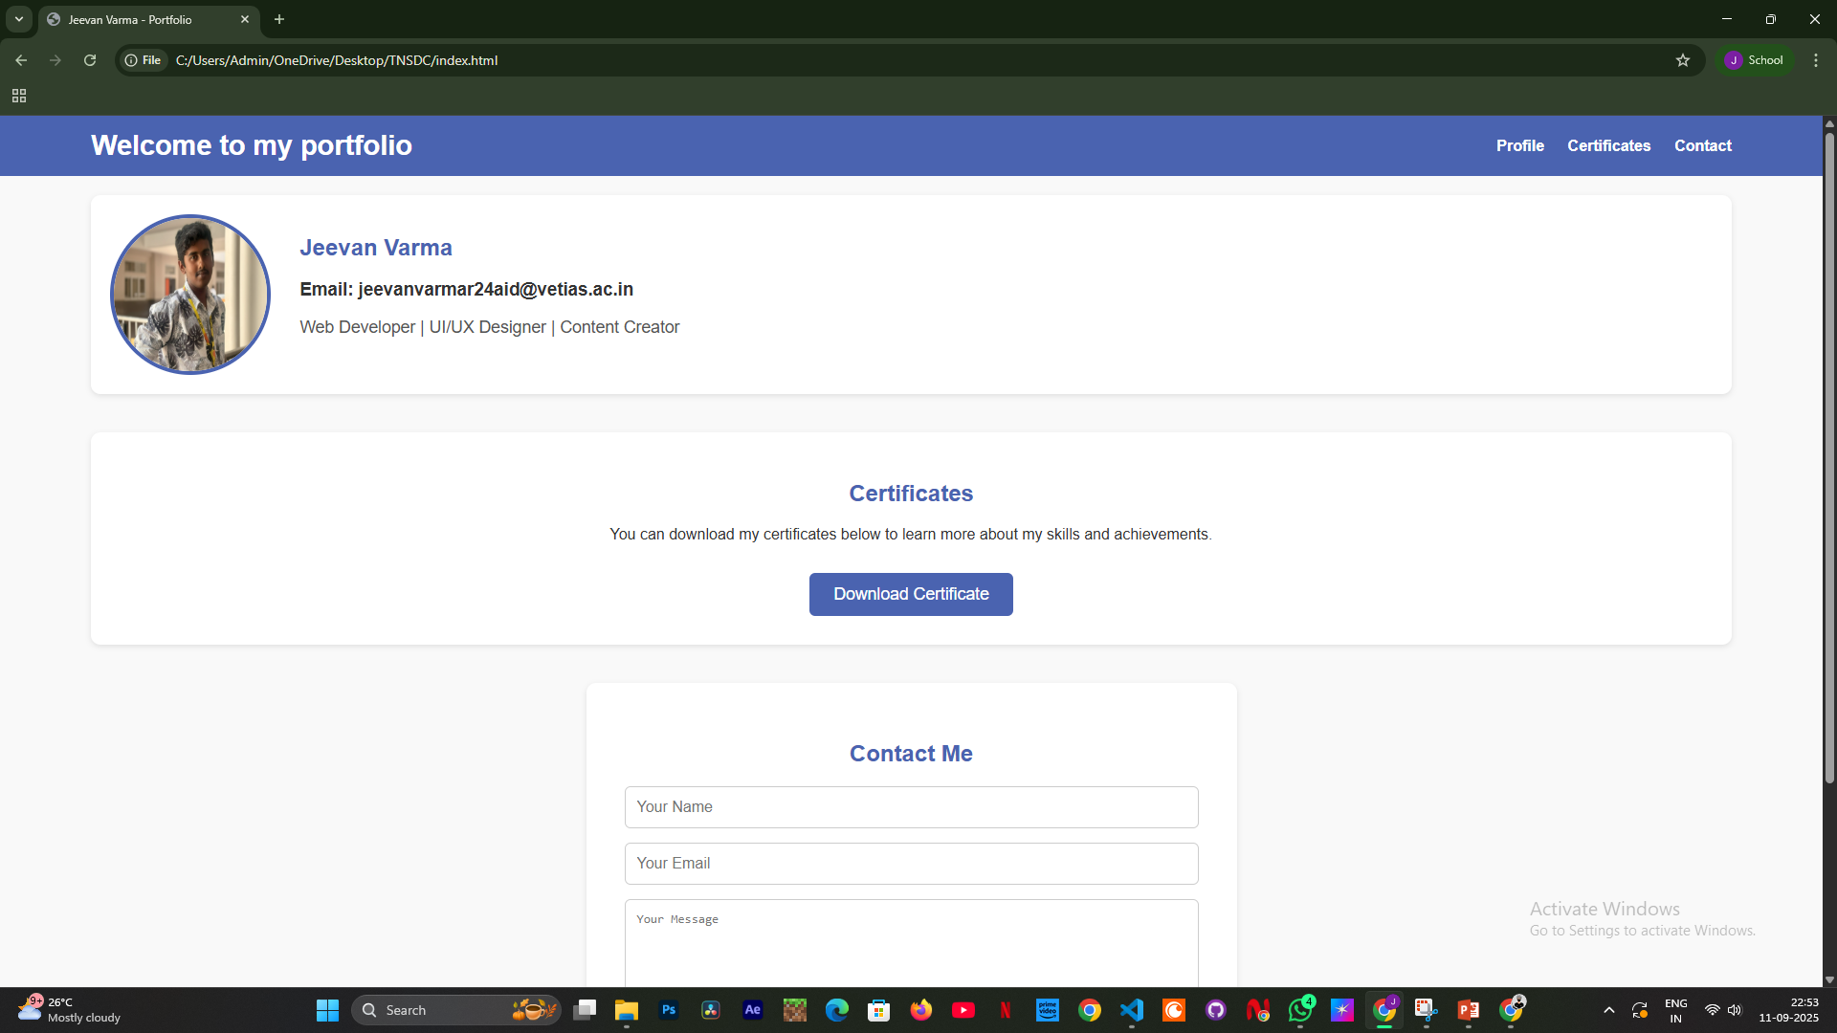

RESULTS AND SCREENSHOTS
3/21/2024 Annual Review
10

Slide 11
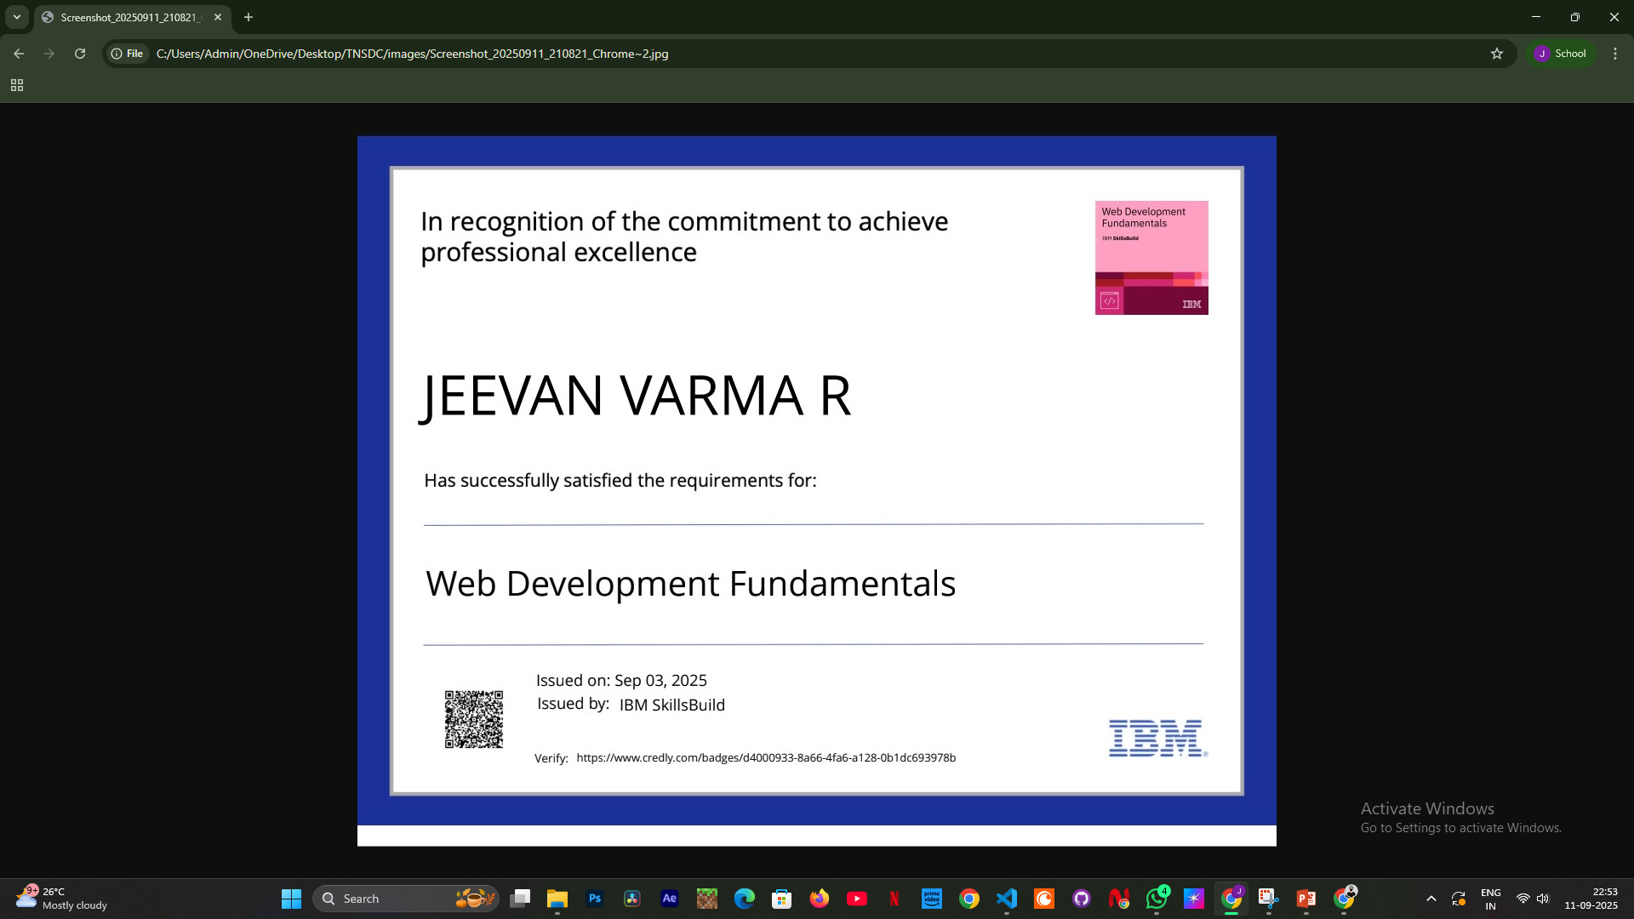

Slide 12
CONCLUSION
The project resulted in the successful creation of a fully functional personal portfolio website that acts as a digital showcase of academic achievements, technical expertise, certifications, and project work.
The portfolio is built with a responsive design, ensuring smooth performance across laptops, tablets, and smartphones. Its well-structured layout makes navigation simple and allows users to access information quickly.Key elements such as education, skills, projects, strengths, and career goals are presented in a clear and organized way, offering a complete professional profile. Unlike traditional resumes, this website delivers a visual, interactive, and engaging presentation of the candidate’s abilities.Overall, the outcome fulfills its objectives by providing a professional, user-friendly, and easily shareable online profile that supports academic recognition, career opportunities, and personal branding.
12

